Slide 1
Chapter 3
Exchanging Materials with the Environment

Slide 2
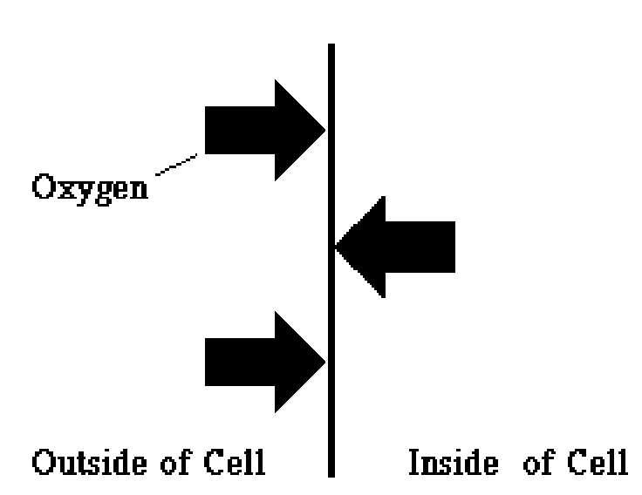
3.1 Exchanged Materials
Cells must be able to exchange materials with its environment

Slide 3
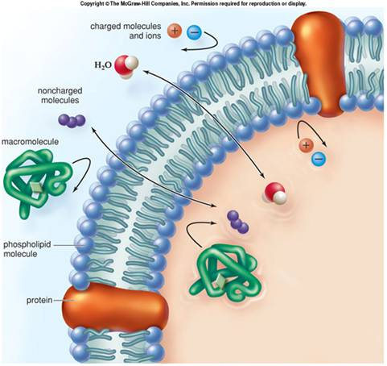
3.1 Exchanged Materials
The cell membrane controls what materials leave and enter the cell
  Selectively Permeable-
    (Semi Permeable)
    Allows some things into the
    cell while keeping other things
    out
    “Gate keeper”
    Useful in maintaining homeostasis
    (a constant internal environment)

Slide 4
3.1 Exchanging Materials
What types of materials does the cell need?
  Water
  Oxygen
  Correct balance of ions
  Autotrophs need Carbon dioxide
  Nutrients (sugars and amino acids)
  Hormones
What about materials leaving the cell?
  Cell waste like Ammonium ion (NH3+)
  Nitrogenous waste
  Carbon dioxide/ Oxygen (depending on cell type)

Slide 5
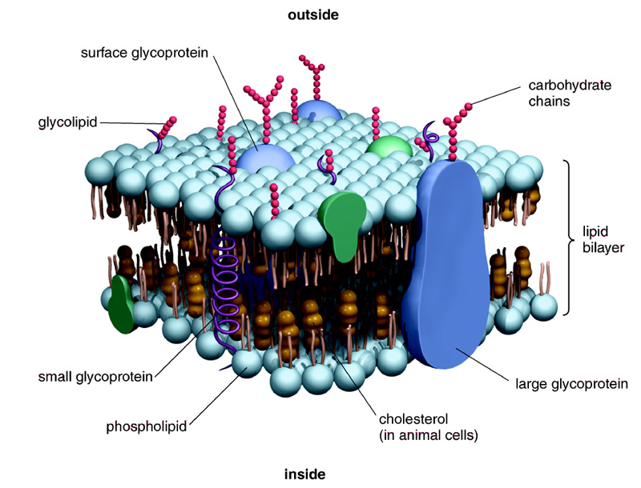
3.2 Membrane as a Barrier

Slide 6
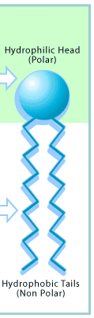
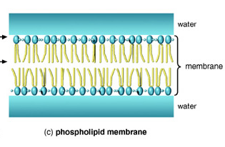
Structure of the cell membrane
Made of phospholipids that form a strong barrier around the cell.
Composed of 2 thin layers of phospholipids and proteins called a lipid bilayer
Phosphate group (Hydrophilic/polar)
Fatty acid tails (Hydrophobic/
Nonpolar)

Slide 7
Hydrophobic and Hydrophilic
Hydrophilic literally translates into “water loving” or “water friend”.
  Hydrophilic substances are attracted to or dissolve well in water.
  Bonds well with polar substances (like water)
Hydrophobic is the opposite
  Hydrophobic substances are repelled by water
  (example: oils, nonpolar substances)

Slide 8
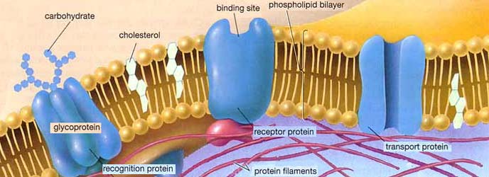
Structure of the cell membrane
The cell membrane is also composed of proteins known as transport proteins embedded throughout.
  These proteins are used as channels and pumps to help move materials across the cell membrane.

Slide 9
Structure of cell membrane
Some proteins embedded in the membranes have sugars attached to them called:
glycoproteins.
Sugars can also be attached to the heads of membrane lipids called:
glycolipids.

Slide 10

The cell membrane is selectively-permeable
Not all substances can enter and leave the cell membrane as they please.
What factors determine a molecules permeability?
  1) Size (large or small)
  2) Polarity (polar or nonpolar)
  3)Charge (ionic or covalent)

Slide 11
What types of molecules can cross the lipid bilayer?
Can Cross
  Small hydrophobic molecules
  like gases
  Small uncharged polar molecules
  like water
Can’t Cross
  Larger uncharged polar molecules
  like amino acids, glucose and nucleotides
  Ions or charged molecules
  like H⁺ or OH⁻

Slide 12
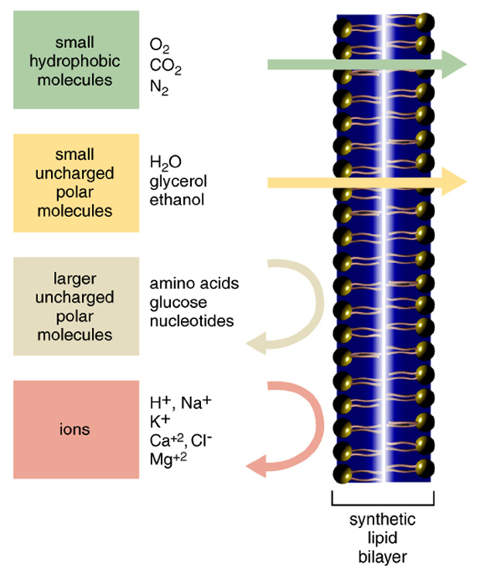
Selectively permeable membrane Figure 3.2

Slide 13
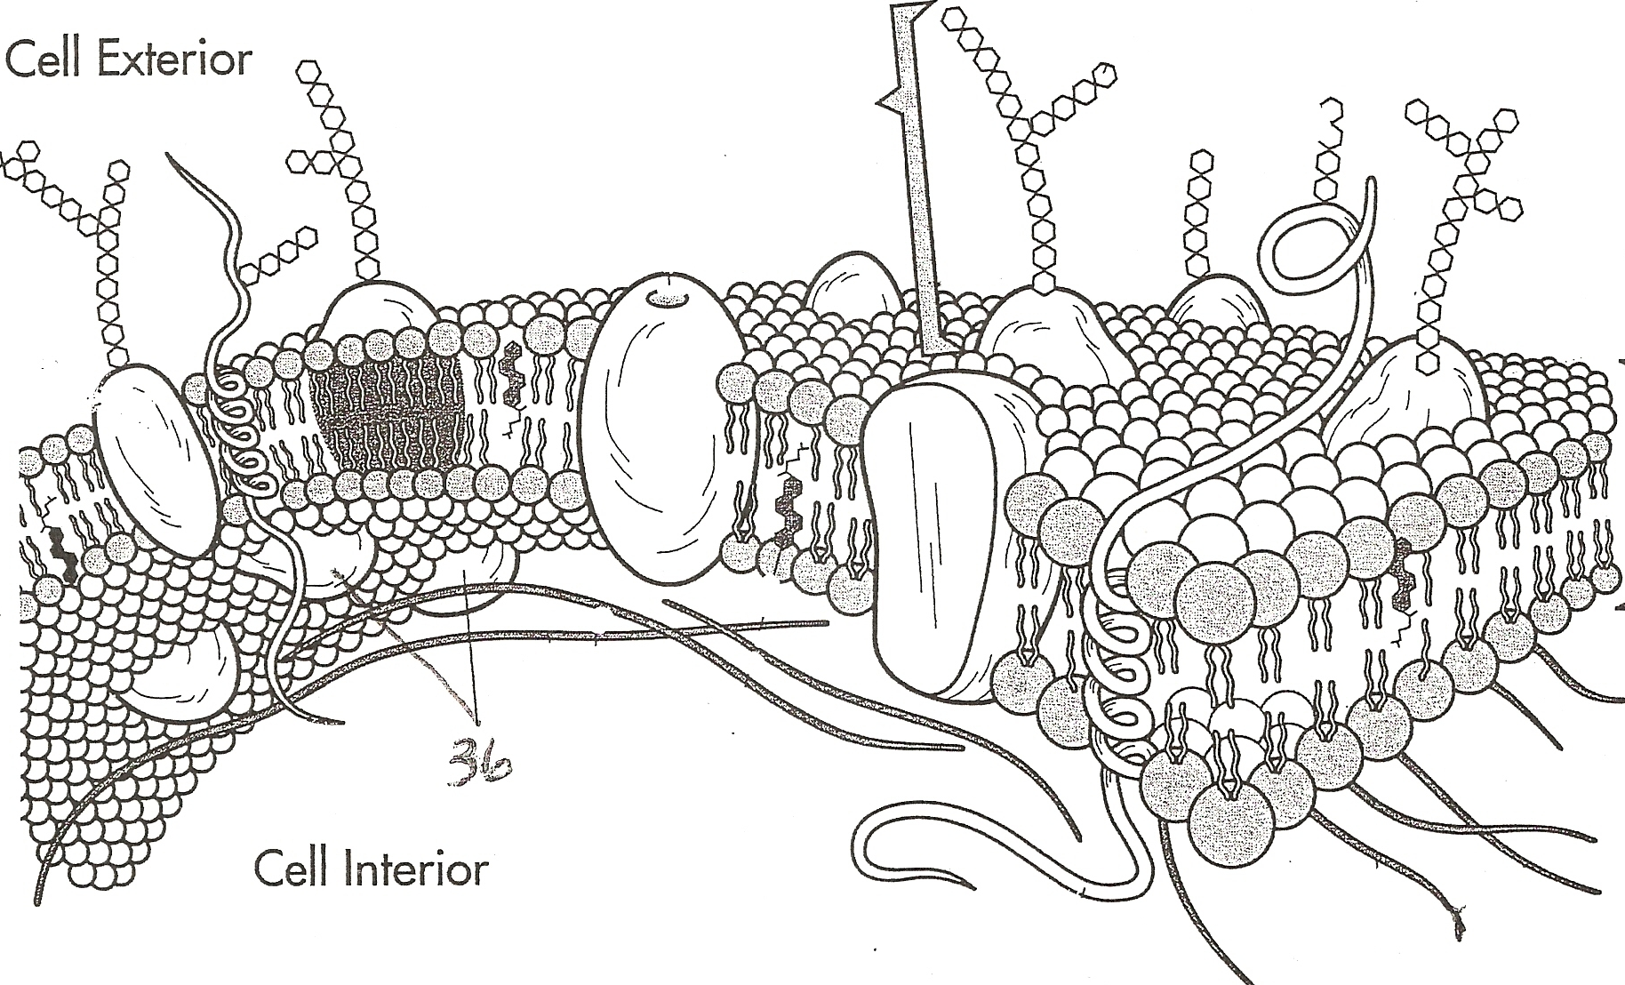
Selectively permeable membrane

