Slide 1
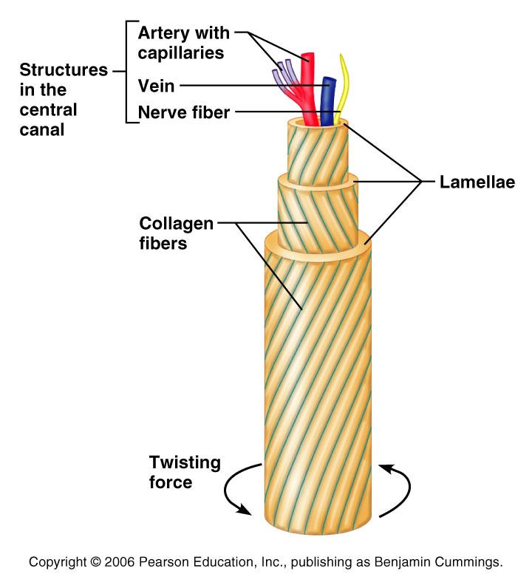
Microscopic Anatomy of Bone
Essentially, four major cell types populate bone tissue:
1) osteogenic cells
2) osteoblasts
3) osteoclasts
4) osteocytes

Slide 2
Microscopic Anatomy of Bone
Bone looks dense and solid, but it is riddled with passageways!!
Osteon (Haversian system)
  Basic structural unit of compact bone
  Tiny weight-bearing pillars → looks like
  growth rings of a tree trunk.

Slide 3
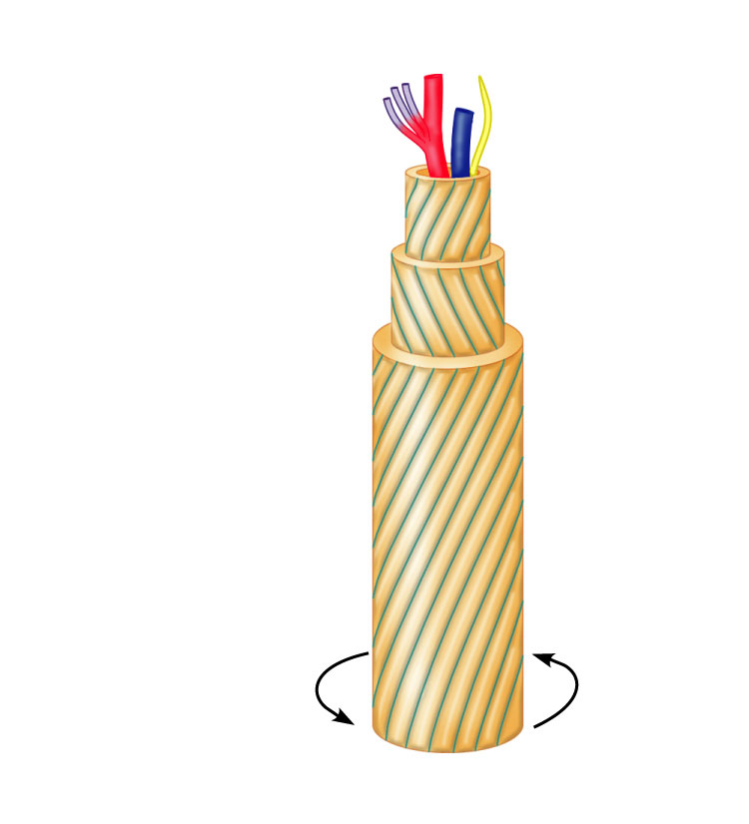
Microscopic Anatomy of Bone
Artery with
capillaries
Structures
in the
central
canal
Vein
Nerve fiber
Lamellae
Collagen
fibers
Twisting
force

Slide 4
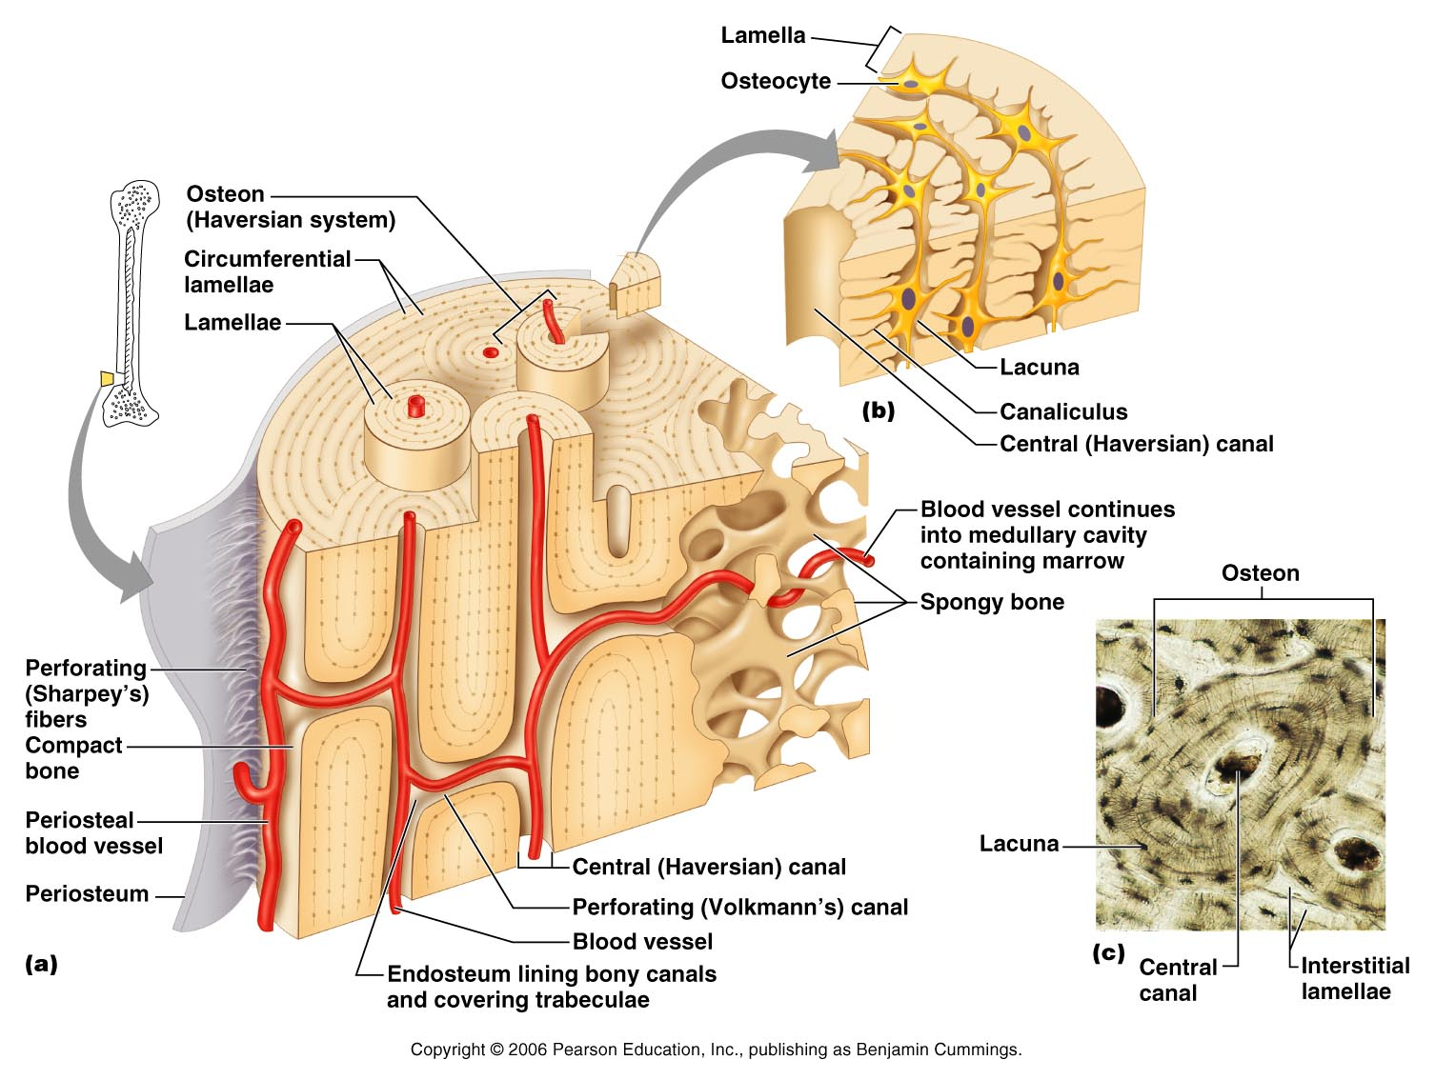
Microscopic Anatomy of Bone
Lamella
  One of the “growth rings”
  Collagen fibers in adjacent lamella run in opposite directions →
  to withstand stresses!!

Slide 5
Microscopic Anatomy of Bone
Haversian canal (Central canal)
  Runs through the center of each osteon.
  Contains blood vessels and nerve fibers
  Extend longitudinally through bone tissue

Slide 6
Microscopic Anatomy of Bone
Perforating canals
(Volkmann’s canals)
  Lie at right angles and connect the blood and nerve supply of the entire bone

Slide 7
Microscopic Anatomy of Bone
Osteocytes
  Mature bone cells

Slide 8
Microscopic Anatomy of Bone
Lacunae
  Osteocytes reside here.
  Lie at the junctions of lamellae

Slide 9
Microscopic Anatomy of Bone
Canaliculi
  Contain slender finger-like projections from osteocytes
  Connect neighboring osteocytes with each other and central canal

Slide 10
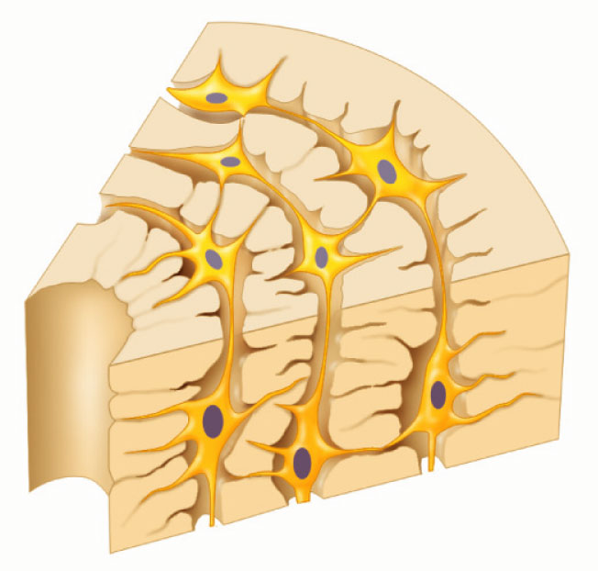
Lamella
Osteocyte
Lacuna
(b)
Canaliculus
Central (Haversian) canal

Slide 11
Microscopic Anatomy of Bone
Canaliculi
  Allow osteocytes to communicate via gap junctions
  Provides routes for nutrients to reach cells and wastes to be removed.

Slide 12
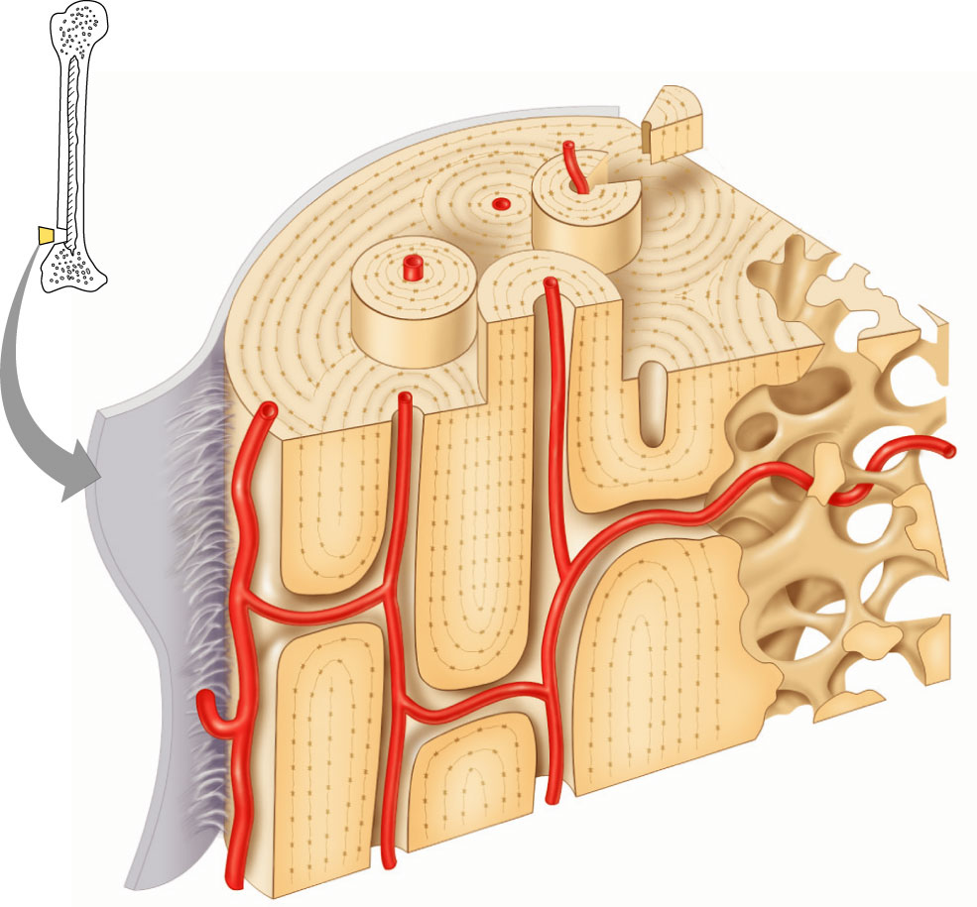
Osteon
(Haversian system)
Circumferential
lamellae
Lamellae
Blood vessel continues
into medullary cavity
containing marrow
Spongy bone
Perforating
(Sharpey’s)
fibers
Compact
bone
Periosteal
blood vessel
Central (Haversian) canal
Periosteum
Perforating (Volkmann’s) canal
Blood vessel
(a)
Endosteum lining bony canals
and covering trabeculae

Slide 13
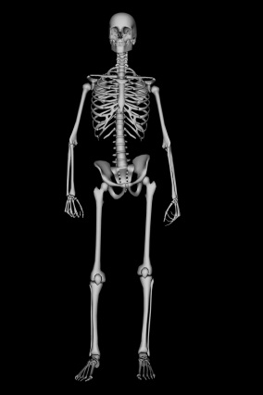
Bone Remodeling
Bone is an active and dynamic tissue.
  Every week we recycle 5-7% of our bone mass!
  Changes in bone architecture occur continually.
  Even after bones reach their adult shapes and sizes, they continue to be renewed.
Remodeling occurs when bone deposits and bone resorption occur together

Slide 14
Bone Remodeling
Occurs: surface of periosteum & endosteum
Coordinated by:
a) Osteoclasts
- bone destroying cells
b) Osteoblasts
- bone forming cells that synthesize the
organic components of the bone matrix

Slide 15
Bone Remodeling
Total bone mass remains constant, rates for both are essentially equal
Bone Deposit
  Occurs wherever bone is injured or added bone strength is required
  Done by osteoblasts
  Bone Resorption
  - Done by osteoclasts

Slide 16
Bone Remodeling
Serves two purposes:
  1) Renews bone tissue before deterioration sets in.
  2) Redistributes bone matrix along lines of mechanical stress (changes throughout life)

Slide 17
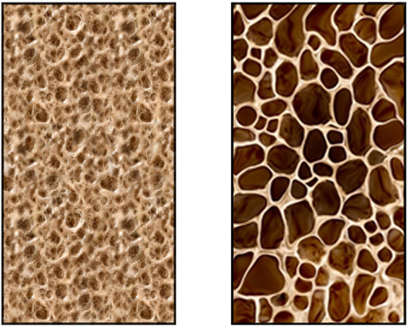
Bone Remodeling
In a healthy person the total bone mass stays constant!
  Amount broken down = amount replaced
When bone tissue remains in place for long periods of time, the calcium crystallizes and becomes brittle.

Slide 18
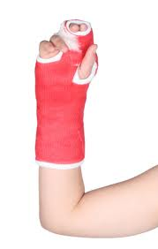
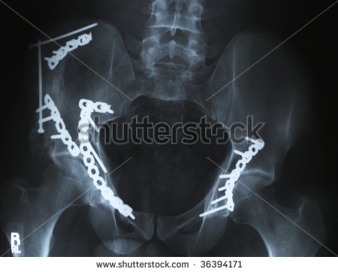
Bone Repair!!
Treated by
Reduction=the realignment of the broken ends
  Closed (external) reduction
    Coaxed into position by physician’s hands
  Open (internal) reduction
    Secured together by pins or wires
Immobilized by a cast or traction to allow healing process to begin

Slide 19
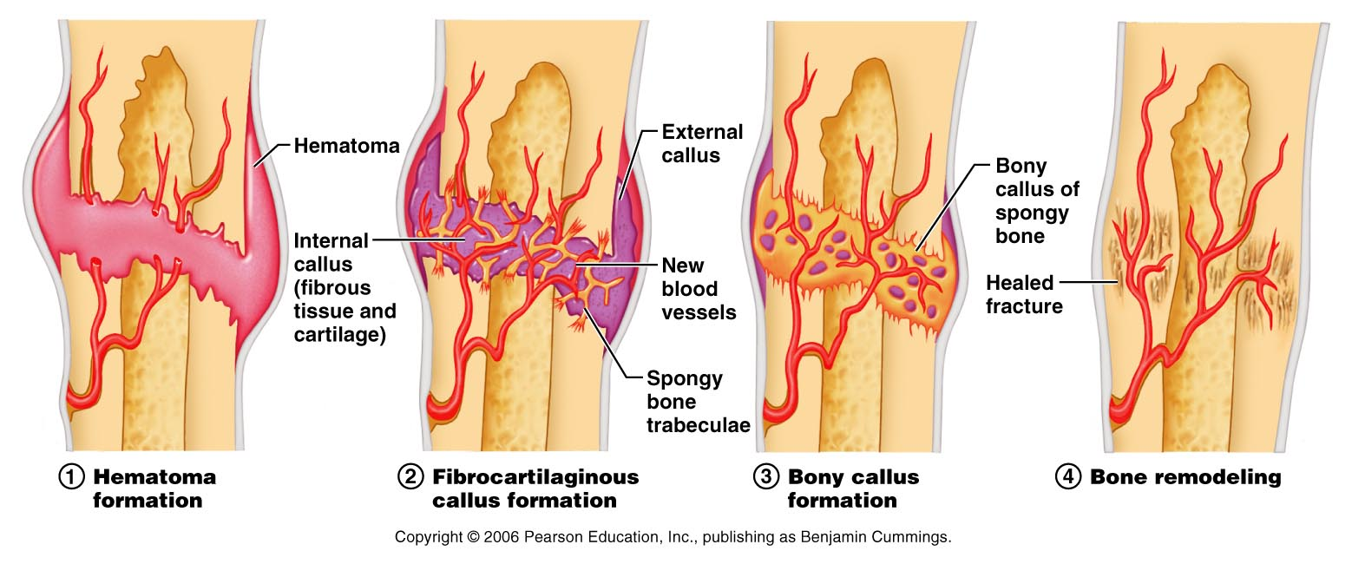
Bone Repair!! - Stages
Hematoma formation
  Blood vessels crossing the fracture line are broken in the bone and periosteum (possibly surrounding tissue) and bleeding occurs.
  Hematoma forms → mass of clotted blood
  Because of reduced blood supply, nearby bone cells around the fracture start to die
  Surrounding tissue becomes swollen and painful

Slide 20
Bone Repair!! - Stages
Fibrocartilaginous callus formation
  Starts within a couple of days → takes about 3 weeks to complete
  Capillaries grow into the hematoma and phagocytic cells invade the area → debris is cleaned up
  Fibroblasts (collagen makers) and osteoblasts (bone makers) invade the area from the surrounding area and begin reconstructing bone

Slide 21
Bone Repair!! - Stages
Fibrocartilaginous callus formation
  Fibroblasts produce collagen fibers → span the break and connect the broken bone end
  Osteoblasts begin forming spongy bone (close to blood supply)
  Some fibroblasts differentiate into chondroblasts → in areas far away from blood supply → secrete a cartilage matrix → bulges externally
  Fibrocartilaginous callus is the body’s natural splint

Slide 22
Bone Repair!! - Stages
Bony callus formation
  Starts within a few days in areas closer to blood supply → 2 months until firm union
  Trabeculae appear in the soft callus → join the living and dead portions of the original bone fragments → gradually converted to a bony (hard) callus of spongy bone
  Lasts about 3-4 months

Slide 23
Bone Repair!! - Stages
Bone remodeling
  Begins during the bony callus and continues for several months afterwards
  Dead portions of the original fragments are gradually resorbed.
  The bony callus is remodeled
    Compact bone replaces spongy bone
    Excess material on sides and insides is removed
  Final structure resembles original bone!

Slide 24
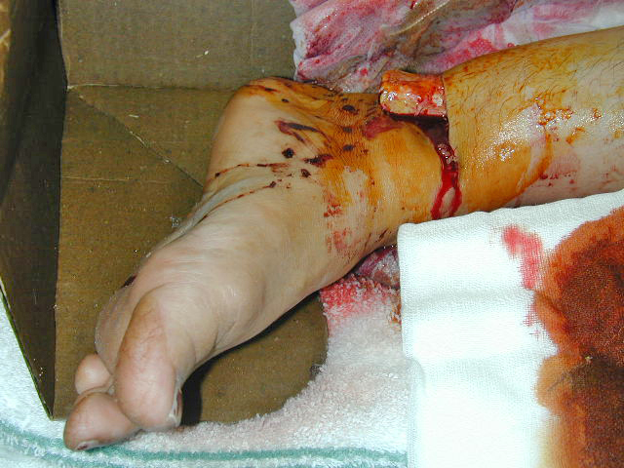
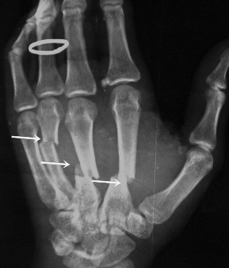
Fractures
Fracture = break in bone

Slide 25
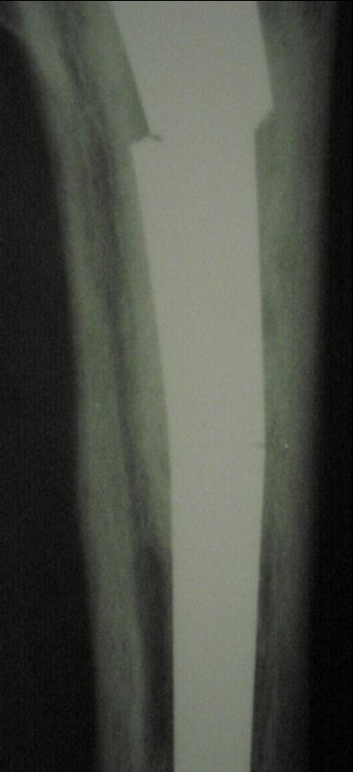
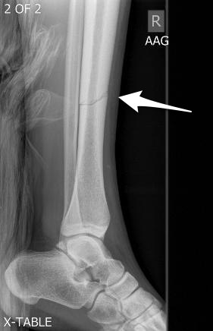
Classification of Fractures
Position of the bone ends after fracture
  Nondisplaced
    Bone ends aligned normally
  Displaced
    Ends of bones out of normal alignment

Slide 26
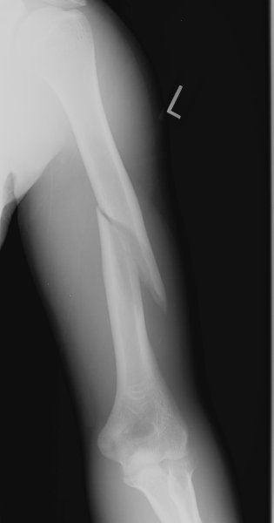
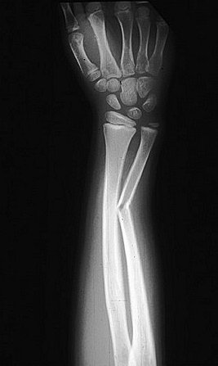
Classification of Fractures
Completeness of the break
  Complete –broken all the way through
  Incomplete – not broken all the way through

Slide 27
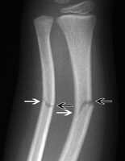
Classification of Fractures
Orientation of the break relative to the long axis of the bone
  Linear – parallel break
  Transverse – perpendicular break

Slide 28
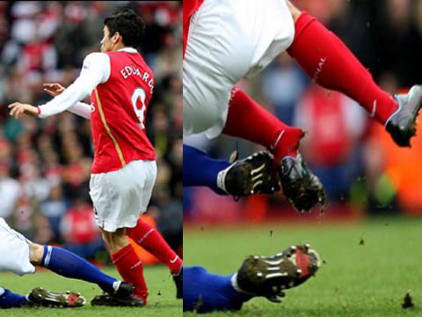
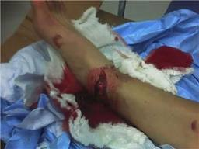
Classification of Fractures
Whether the bone ends penetrate the skin.
  Compound (open) – bone penetrates skin
  Simple (closed) – bone doesn’t penetrate the skin

Slide 29
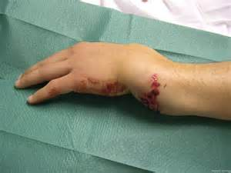
Classification of Fractures
Fractures may also be described in terms of
1) location
2) external appearance
3) the nature of the break.

Slide 30
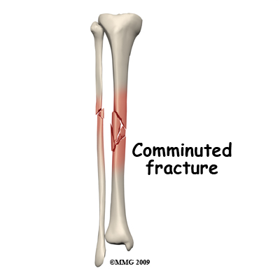
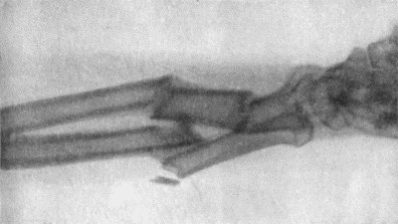
Common Types of Fractures
Comminuted
  Complete bone fracture
  Bone fragments into three or more pieces.
  Particularly common in older people whose bones are more brittle.

Slide 31
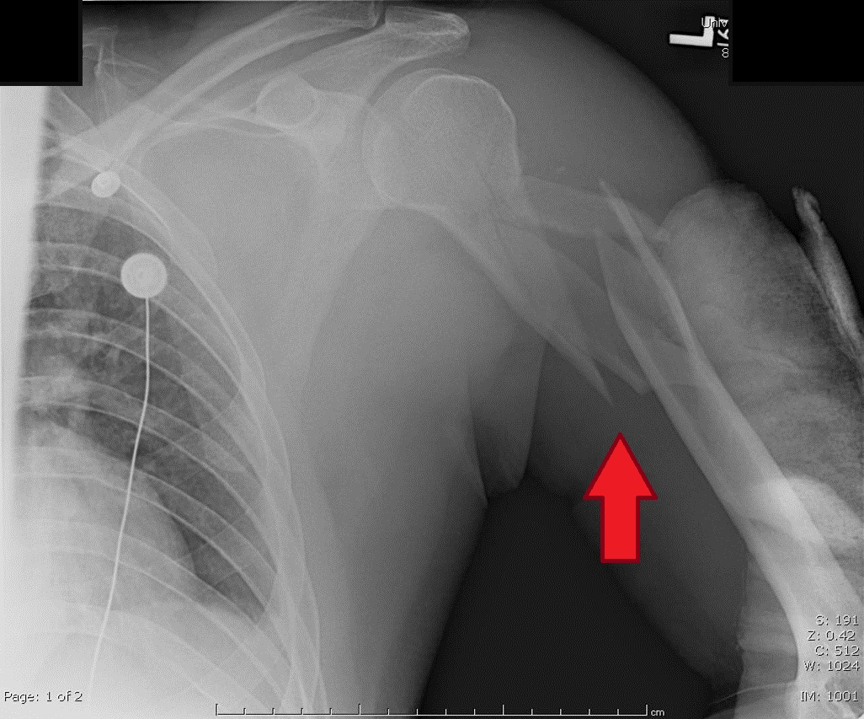
Common Types of Fractures

Slide 32
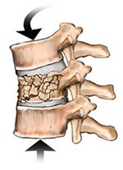
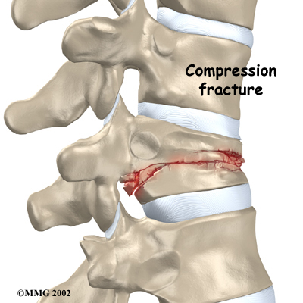
Common Types of Fractures
Compression
  Bone is crushed
  Common in porous bones subjected to extreme trauma (falling)
  Most often seen with spine

Slide 33
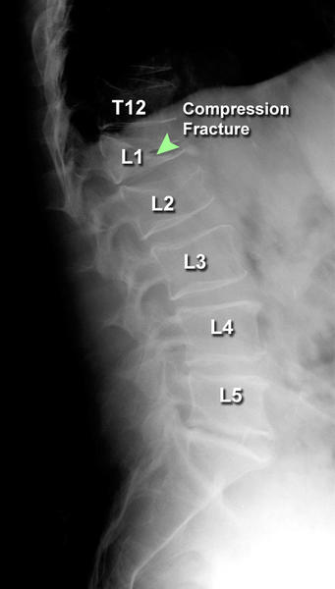
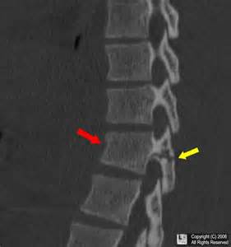
Common Types of Fractures

Slide 34
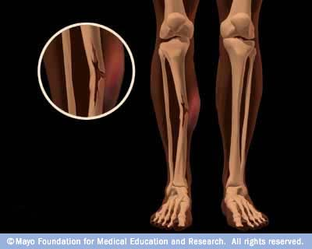
Common Types of Fractures
Greenstick Fracture
  One side of the bone breaks; the other side bends
    Much in the way a green twig breaks
  Common in children, whose bones are more flexible than those of adults

Slide 35
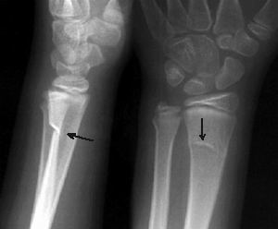
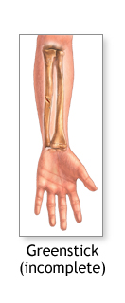
Common Types of Fractures

Slide 36
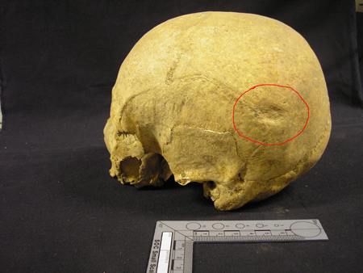
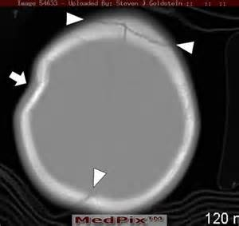
Common Types of Fractures
Depressed
  Broken bone portion is pressed inward.
  Typical of a skull fracture.

Slide 37
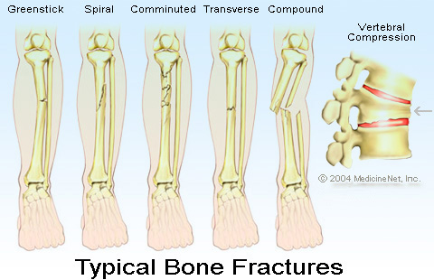
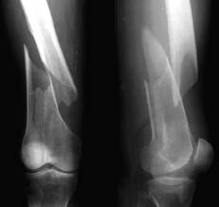
Common Types of Fractures
Spiral
  Ragged break occurs when bone is twisted excessively
  Common sports fracture

Slide 38
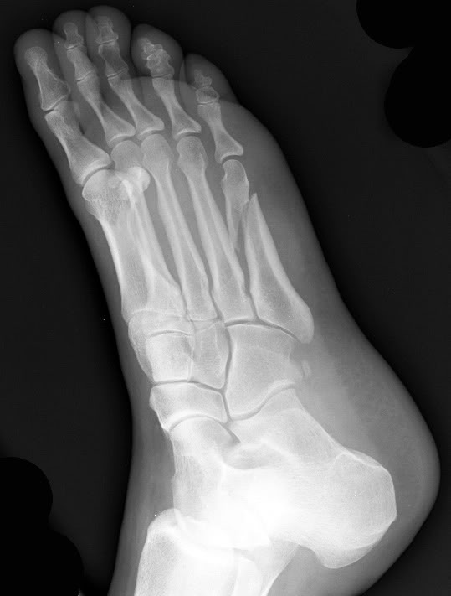
Common Types of Fractures
Spiral

Slide 39
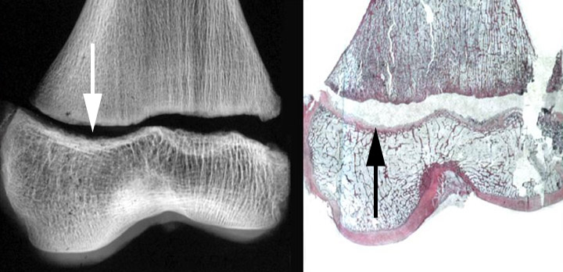
Common Types of Fractures
Epiphyseal
  Epiphysis separates from the diaphysis along the growth plate
  Tends to occur where cartilage cells are dying and calcification of matrix is happening

Slide 40
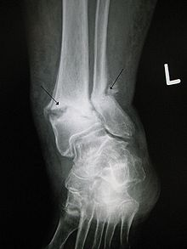
Common Types of Fractures
Pott’s fracture
  Distal end of the lateral leg bone (fibula), with serious injury of the distal tibial articulation
  Often caused in the same way of a lateral ankle sprain

Slide 41
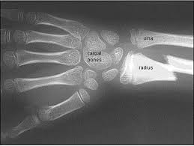
Common Types of Fractures
Colles’ fracture
  Distal end of the lateral forearm bone (radius) in which the distal fragment is displaced posteriorly
  Most commonly caused by falling onto a hard surface with outstretched arms.

