Slide 1
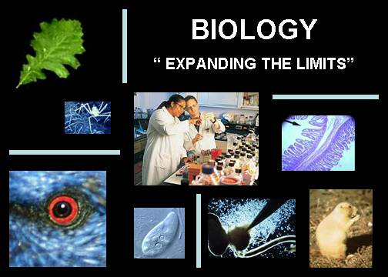
Chapter 1 – Chemistry of Life
How is Chemistry related to Biology?
  Four elements – carbon (C), oxygen (O), hydrogen (H), and nitrogen (N) make up 96% of living matter.

Slide 2
Review of the Atom
Atoms – the basic unit of all matter
Subatomic Particle | Charge | Location
Protons | + | Center of atom (nucleus)
Neutrons | 0 | Center of atom (nucleus)
Electrons | - | “cloud” around the nucleus
Atoms are electrically neutral.
  # protons = # electrons

Slide 3
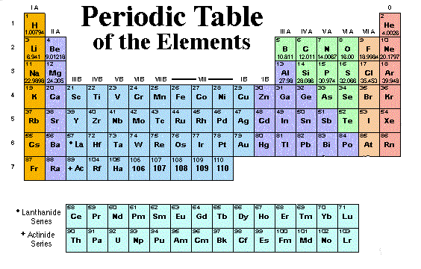
The Periodic Table

Slide 4
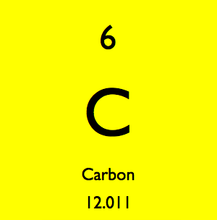
The Periodic Table
Atomic number = number of protons
Atomic mass = protons + neutrons
Atomic
Number
Element
Atomic
Mass

Slide 5
Bonding
Compounds and molecules form by the chemical combination of two or more elements.
The number of valence (outermost) electrons determines the chemical activity and bonding ability of an atom.
Atoms combine (bond) to fill these outermost shells.
  First shell is full with 2 electrons.
  The remaining shells are “full” with 8 electrons.

Slide 6
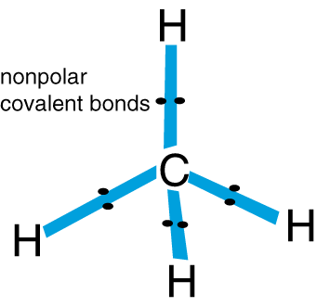
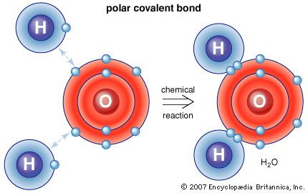
Covalent Bonds – share valence electrons
Non-polar Covalent Bonds – share electrons equally
Polar Covalent Bonds – share electrons unequally
  results in the two ends (poles) having slight positive and negative charges.

Slide 7
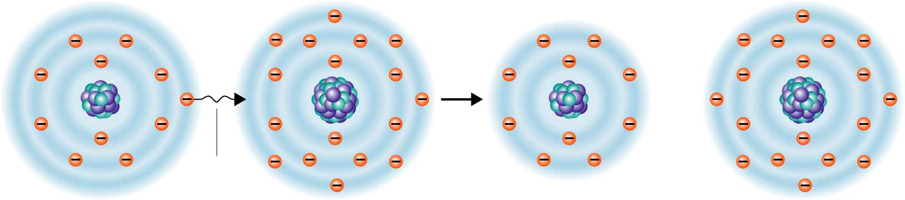
Ionic Bonding
Ionic bonds form between atoms when there is a transfer of electrons between one another.
  When an atom loses an electron… becomes a (+) ion.
  When an atom gains an electron… becomes a (-) ion.
Opposite charges attract, forming the bond.
Sodium atom (Na)
Chlorine atom (Cl)
Sodium ion (Na⁺)
Chloride ion (Cl⁻)
Transfer
of electron
Protons +11
Electrons -11
Charge 0
Protons +17
Electrons -17
Charge 0
Protons +11
Electrons -10
Charge +1
Protons +17
Electrons -18
Charge -1

Slide 8
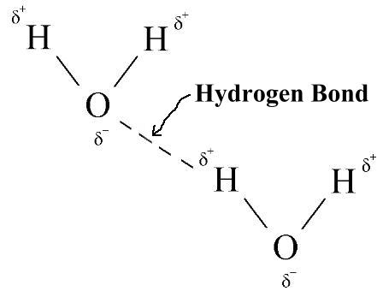
Hydrogen Bonding
Hydrogen Bond – a weak attraction between two polar molecules
  The slight positive end of one polar molecule is attracted to the slight negative end of another polar molecule.
  Example: WATER!!!

Slide 9
Carbon Compounds
Large molecules that contain carbon and hydrogen atoms
4 carbon compounds in all living things…
  Carbohydrates
  Lipids
  Proteins
  Nucleic Acids

Slide 10
Making Macromolecules
Monomers – smaller units (subunits) that join together to make larger molecules
Polymers – a long molecule consisting of many similar or identical building blocks
Monomer 1
Monomer 2
Monomer 3
Monomer 4
Polymer

Slide 11
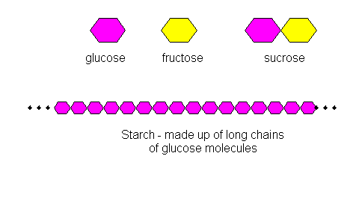
 | Carbohydrates
Elements
Monomers/ Basic Units
Functions
Location in Cell
Examples
C, H, O (1:2:1)
sugars
Short-term energy for cells
Mitochondria
Simple sugars/ monosaccharides (glucose, fructose)
Polysaccharides (cellulose, starch, glycogen)

Slide 12
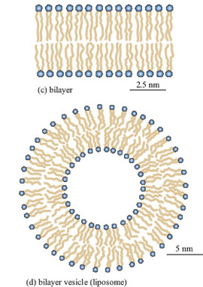
 | Lipids
Elements
Monomers/ Basic Units
Functions
Location in Cell
Examples
C, H
Glycerol & Fatty Acid
Long-term energy for cells
Water-proofing
Insulation
Make up membranes around cells
Biological Membranes
Fats, Oils, Waxes, Phosholipids

Slide 13
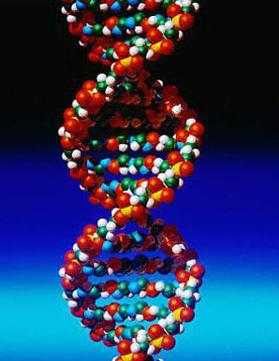
 | Nucleic Acids
Elements
Monomers/ Basic Units
Functions
Location in Cell
Examples
C, H, O, N, P
Nucleotides
Store and transmit hereditary info
Nucleus
DNA
RNA

Slide 14
 | Proteins
Elements
Monomers/ Basic Units
Functions
Location in Cell
Examples
C, H, O, N
Amino acids
Control reaction rates
Regulate cell processes
Transport substances in cells
In membranes and cytoplasm
Enzymes
Make up parts of hair, nails, skin

Slide 15
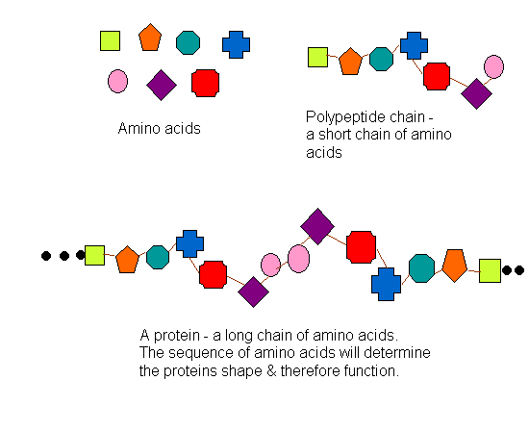
Proteins, cont’d

Slide 16
Section 2-3
Concept Map
Carbon
Compounds
include
Carbohydrates
Lipids
Nucleic acids
Proteins
Which are made of
Which are made of
Which are made of
Which are made of
Simple sugars
Nucleotides
Amino Acids
Glycerol/3 fatty
Acid Subunits
which contain
which contain
which contain
which contain
Carbon,
hydrogen,
oxygen
Carbon,
hydrogen,
Carbon,hydrogen,
oxygen, nitrogen,
phosphorus
Carbon,
hydrogen,oxygen,
nitrogen,

Slide 17
Chemical Reactions
A chemical reaction is a process that changes one set of chemicals into another set of chemicals.
  Involves the breaking of bonds in the reactants and the formation of bonds in the products.
  Reactants – the elements or compounds that enter the reaction
  Products – the elements or compounds that are produced by the reaction.
Reactants ----------> Products
2H₂ + O₂ --------> 2H₂O

