Slide 1

What is Science?
Is there some way to explain the world around us?
Assume that all events in nature have natural causes.
Try to arrange a series of observations and tests to learn what those causes are.
This is science!

Slide 2

Goals of Science
To understand the world around us.
Investigate & understand nature
Use explanations to make useful predictions
Combines what you already know with new observations to effectively solve problems.

Slide 3
Science vs. Pseudoscience
Science
Pseudoscience
Deals with HOW the world is
Seeks explanation through observation, evidence, or experimentation
A methodology that is considered to be without scientific foundation
Deals with how people WISH the world was, BELIEVE to be true, or WANT to be true
Starts with answers which are often invulnerable to experimentation
Skepticism is discouraged
Distinguishing science from “psuedoscience” involves the scientific method.

Slide 4
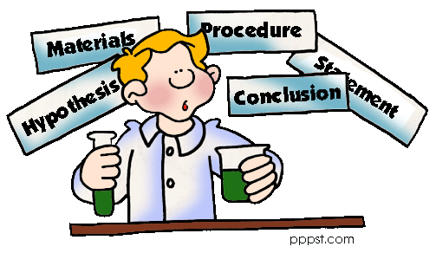
The Scientific Method
Make an Observation and State the Problem
Form a Hypothesis
Test the Hypothesis with a Controlled Experiment.
Record and Analyze Data – Tables and Graphs
Draw a Conclusion.
Does it end here???
  Retest/ Repeat
  Make any changes

Slide 5
Observation vs. inference
Observations
Inferences
Uses one or more of the fives senses to gather information.
Two Types:
Quantitative – involves numbers
  Mass, volume, distance (often made with the use of tools)
Qualitative – descriptions that do not use numbers
  Examples: sounds, texture, colors, tastes
Making a guess or prediction based on what you observed.
Example:
Observation – The ball is orange.
Inference – It must be a basketball.

Slide 6
Fact vs. Law
Fact
Law
An observation that has been repeatedly confirmed
Example: the American flag is red, white, and blue
A descriptive generalization about how some aspect of the natural world behaves under stated circumstances
Example: The orbit of every planet is an ellipse with the Sun at one of the two foci.
(Kepler’s 1st Law)

Slide 7
Hypothesis vs. Theory
Hypothesis
Theory
Educated guess to answer a question or solve a problem
Must be testable!
A set of universal statements that explain the natural world
Well substantiated
Based on evidence
Explain a wide variety of phenomena
Not used to find the “truth,” but to explain
Examples: atomic theory, cell theory, theory of gravity, theory of evolution

Slide 8
