Slide 1
Axial Skeleton
Vertebral Column composed of 26 bones of the 80 total that make up the Axial Skeleton

Slide 2
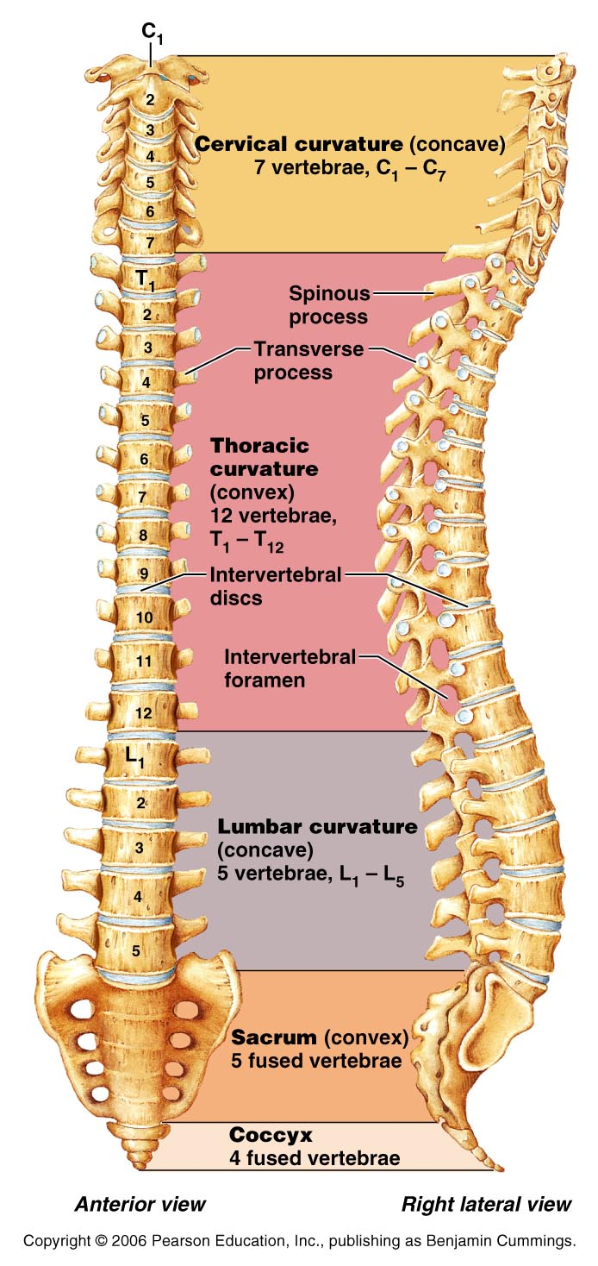
Vertebral Column
Aka → Spine or backbone
Formed from 26 irregular bones
Connected in a way that the flexible curved structure is formed
Along with sternum and ribs, forms the trunk of the body

Slide 3
Functions of the Vertebral Column
1) Surrounds and protects the spinal cord
2) Provides attachment points for the ribs and back and neck muscles
3)Transmits weight of the trunk to the lower limbs

Slide 4
Divisions
Cervical - 7
  Neck
Thoracic - 12
  Ribs
Lumbar - 5
  Lower back
Sacrum - 5
  Articulates with pelvic bones
Coccyx – 4 (3-5)
  Tailbone

Slide 5
Curvatures
When viewed from the side, you see 4 slight bends or curvatures that give it an “S” shape.
Increases the resilience and flexibility of the spine
Helps to absorb shock during walking
Protects the vertebrae from fracture

Slide 6
Curvatures
Cervical and Lumbar
  Concave (curve in)
Thoracic and Sacral
  Convex (curve out)

Slide 7
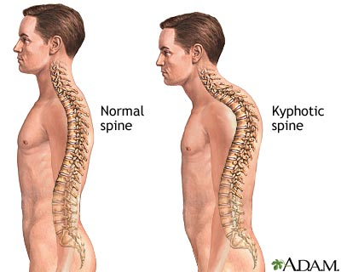
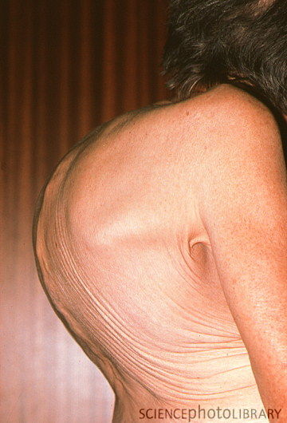
Kyphosis
Hunchback
Dorsally exaggerated thoracic curvature
Common in elderly because of osteoporosis
May also result from tuberculosis of the spine, rickets, or osteomalacia

Slide 8
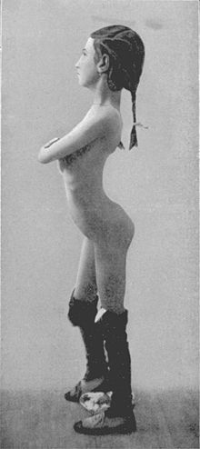
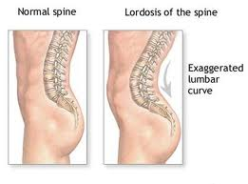
Lordosis
Swayback
Accentuated lumbar curvature
Common in those with an increase in abdominal weight
  Men with potbellies
  Pregnant women
An attempt to preserve the center of gravity they throw their shoulders back

Slide 9
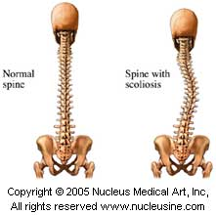
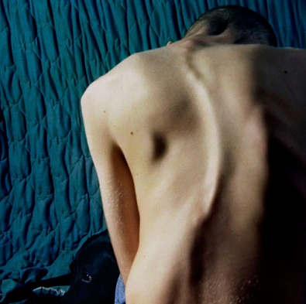
Scoliosis
“twisted disease”
Abnormal lateral curvature most often seen in thoracic region
Most common in girls during late childhood

Slide 10
Types of Vertebrae
Cervical
Thoracic
Lumbar

Slide 11
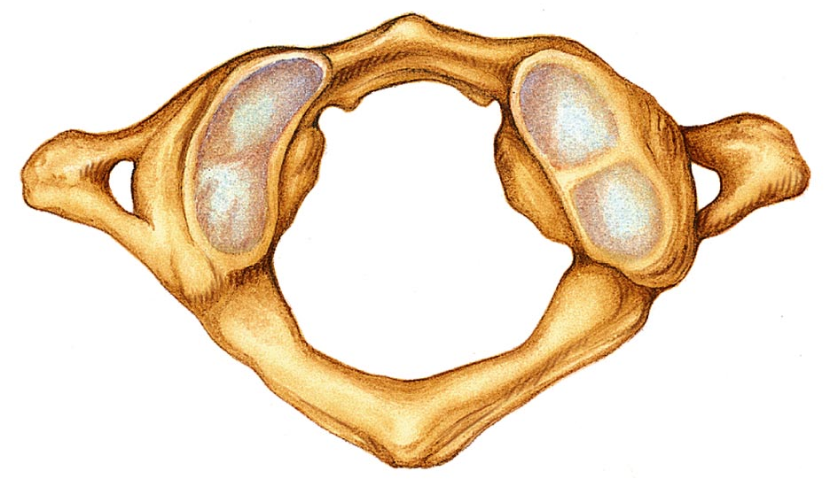
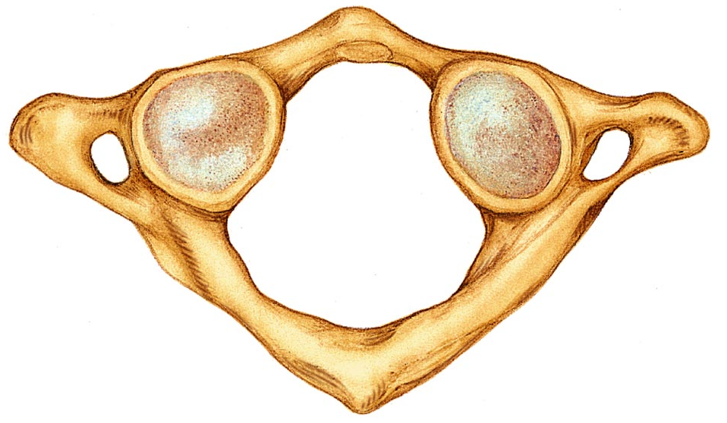
Atlas
1st cervical Vertebrae - C₁
Supports the head
Named for mythological Atlas who supported the world on his shoulders
Ring of bone
No body or spinous process
Allows for “Yes” motion

Slide 12
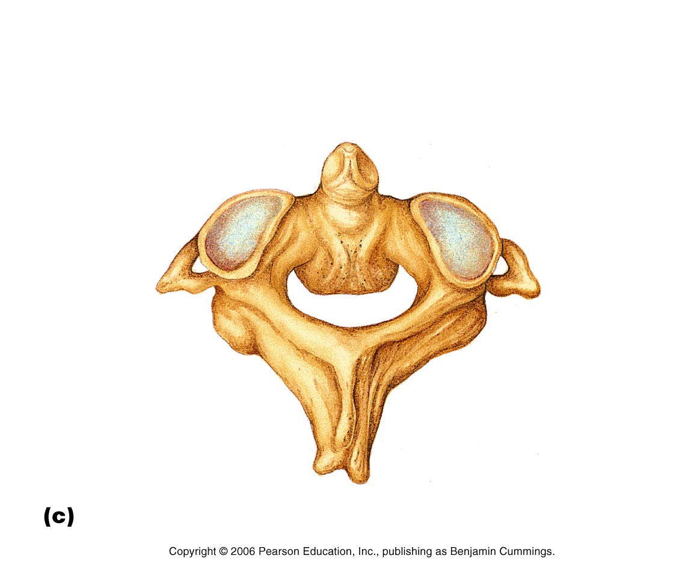
Axis
2nd cervical Vertebrae – C₂
Has body and spinous process
Has a dens (odontoid process)
  Missing body of the atlas which fuses during development
Dens is a pivot that the atlas can rotate around allowing for “No” motion

Slide 13
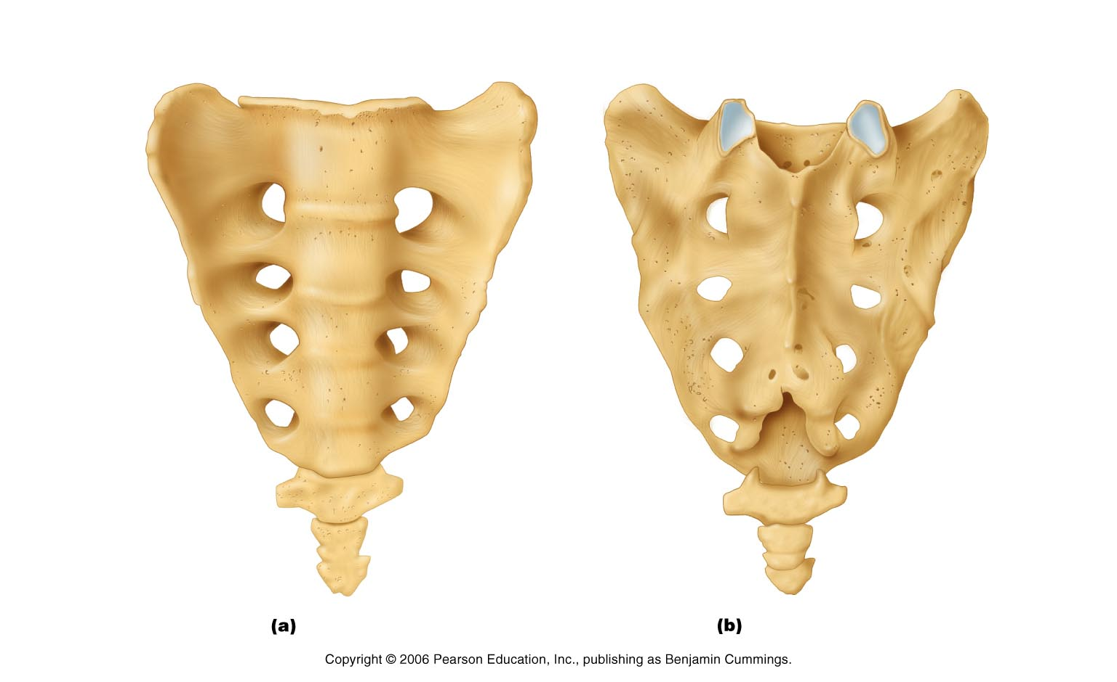
Sacrum
5 fused bones
Triangular
Shapes the posterior wall of the pelvis

Slide 14
Coccyx
Tailbone
4 Fused bones (3-5)
Slight support of pelvic organs

Slide 15
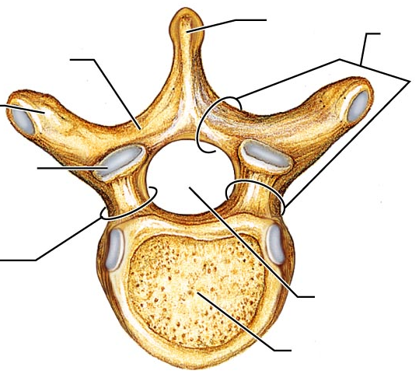
Body (Centrum)
Disc-shape; weight bearing (anterior) region
Body

Slide 16
Pedicle
“little feet”
Short bony pillars
Project posteriorly from body
Forms sides of arch
Pedicle

Slide 17
Lamina
Flattened plates
Join to form the posterior portion of the arch
Lamina

Slide 18
Vertebral Arch
Vertebral Arch
Extends posteriorly from the body
Made up of the pedicle and laminae
Body and arch enclose the vertebral foramen

Slide 19
Vertebral Foramen
Formed from the vertebral arch and body
Contains the spinal cord
Vertebral foramen

Slide 20
Spinous Process
Spinous Process
Median posterior projection
Seen at the junction of the two laminae
Points of muscle attachment

Slide 21
Transverse Process
Extends laterally from each side of the arch
Points of muscle attachments
Transverse Process

Slide 22
Axis Only
Dens
(odontoid process)
Dens acts as a pivot for the atlas. Allows you to rotate your head from side to side

Slide 23
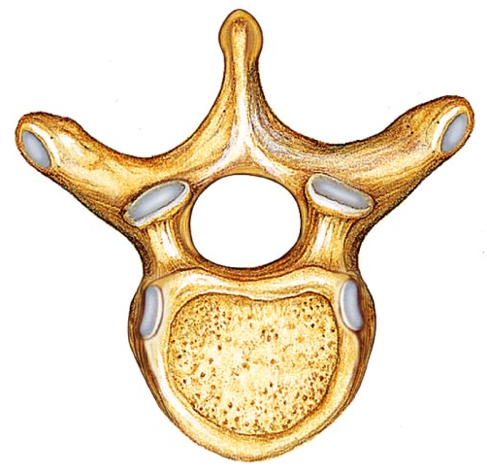
Rib Articulations
Transverse costal facet
Demifacet

Slide 24
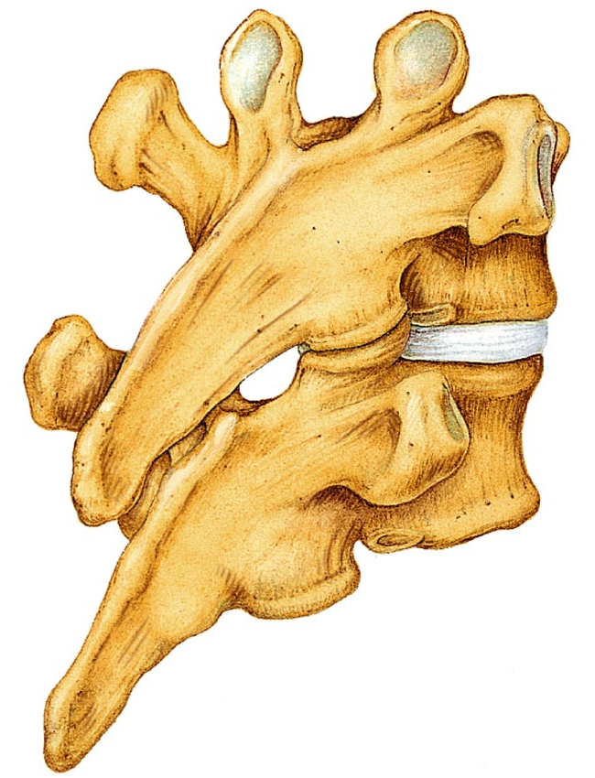
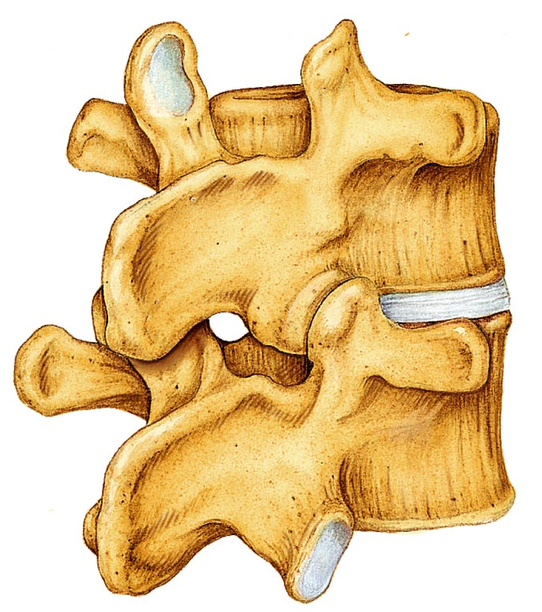
Superior Articular Process
Seen on superior side of vertebra
Articulate with the inferior articular process of the vertebra above it
Superior Articular Process

Slide 25
Inferior Articular Process
Seen on the inferior side of the vertebra
Articulate with the superior articular process of the vertebra below it
Inferior Articular Process

Slide 26
Intervertebral Disc
Cushion-like pad that acts as a shock absorber during activity
Allows the spine to flex, extend, and bend laterally
Thickest in the cervical and lumbar regions to allow for greater movement
Flatten during the day so we are taller in the morning than in the evening
No disc between first two cervical vertebrae

Slide 27
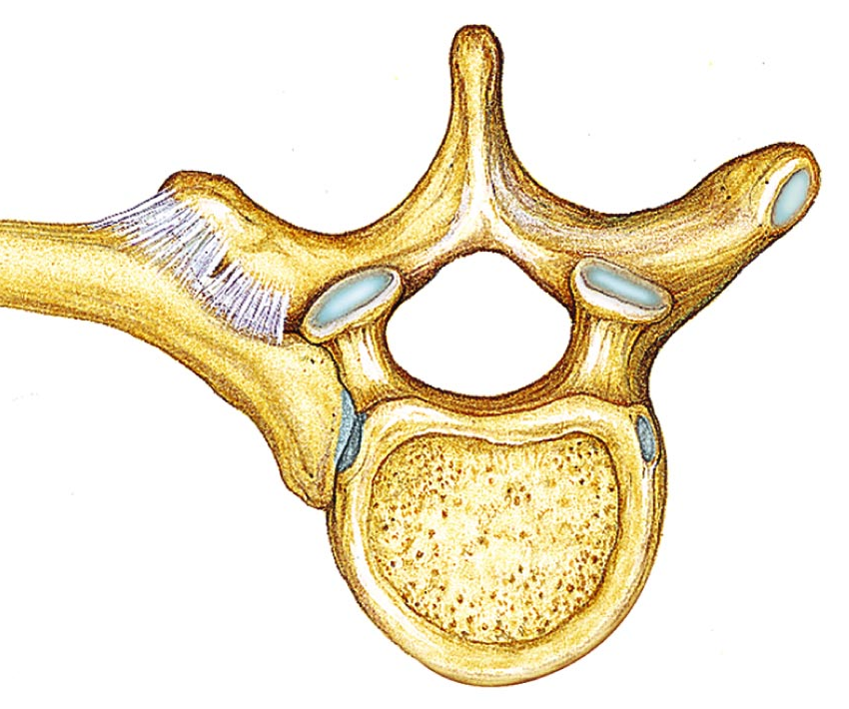
Transverse Costal Facet
Facets on thoracic transverse process
Articulate with the tubercle of the rib

