Slide 1
Cranial Bones
6 kinds
8 total bones

Slide 2
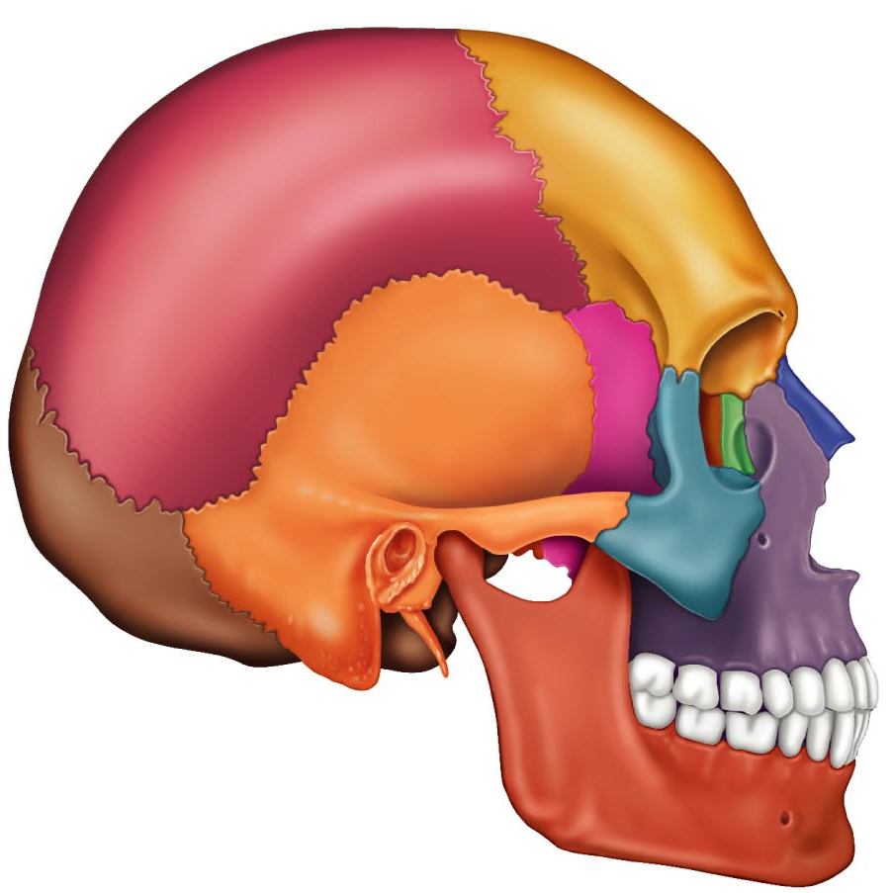
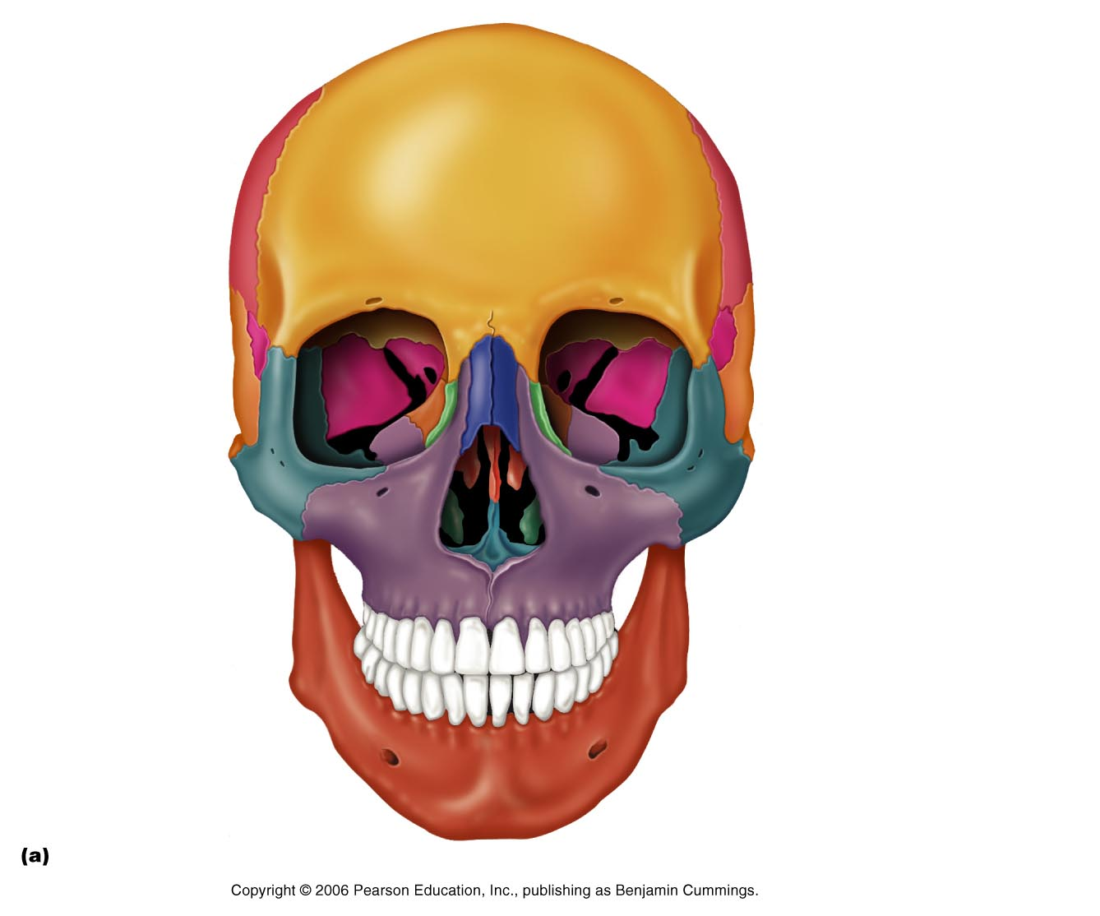
Ethmoid

Slide 3
Frontal
Frontal
Frontal

Slide 4
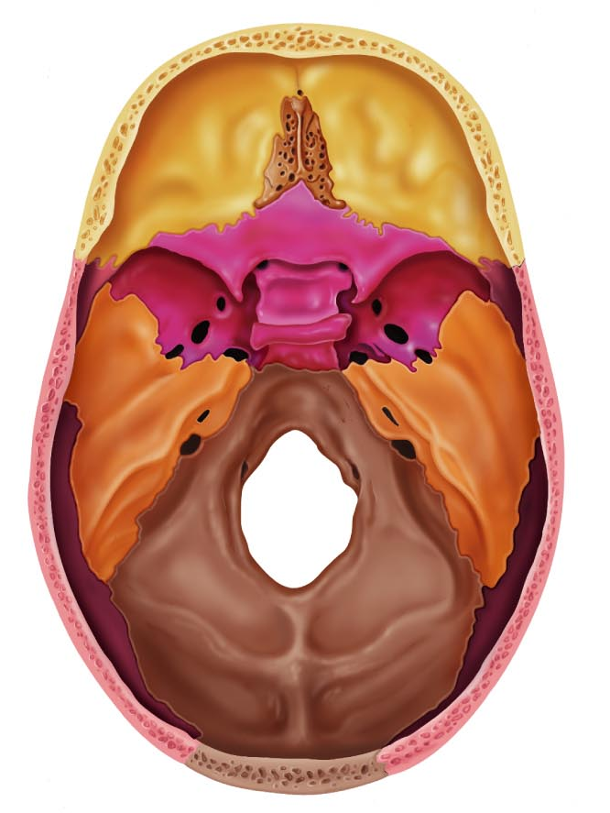
Frontal
Frontal

Slide 5
Occipital
Occipital
Occipital

Slide 6
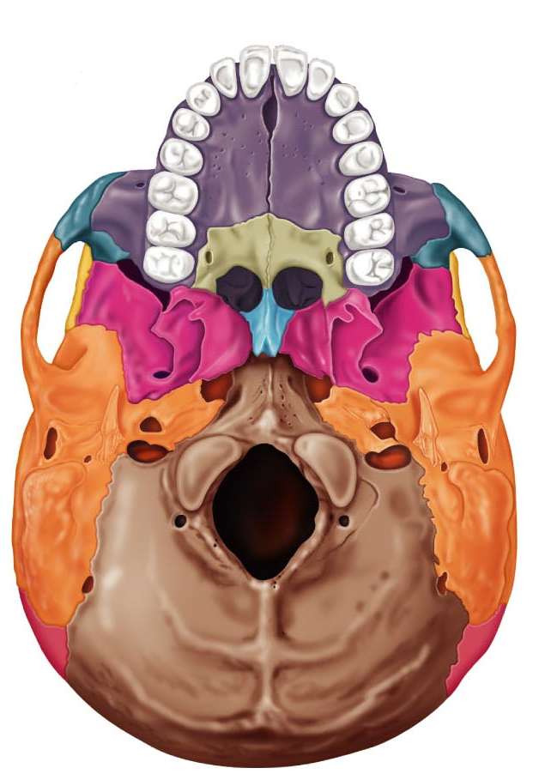
Occipital
Occipital
Occipital

Slide 7
Parietal
Parietal

Slide 8
Parietal

Slide 9
Sphenoid

Slide 10
Sphenoid
Sphenoid

Slide 11
Temporal
Temporal

Slide 12
Temporal
Temporal
Temporal
Temporal
Temporal

Slide 13
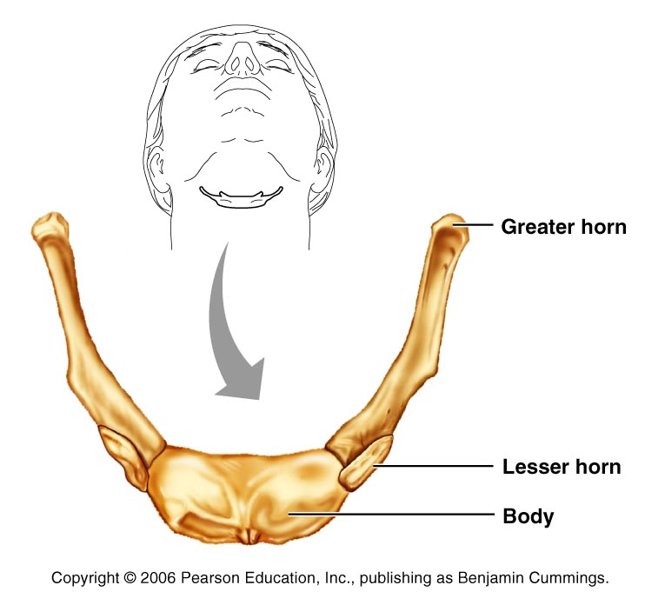
Hyoid not really part of the skull only bone that does not articulate directly with any other bone

Slide 14
14 BONES TOTAL
FACIAL BONES

Slide 15
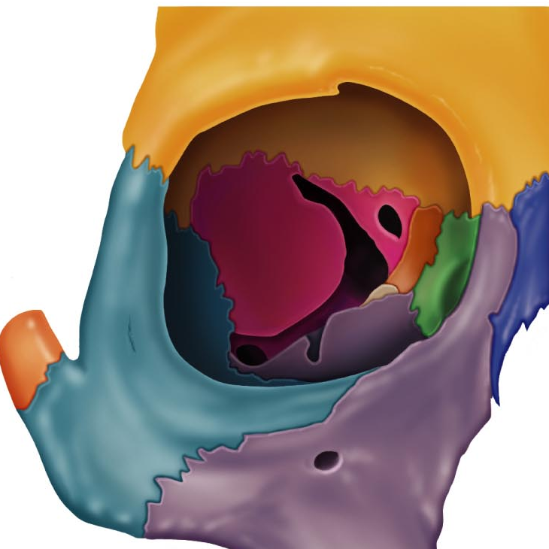
Lacrimals (2)

Slide 16
Mandible (1)
Mandible
Mandible

Slide 17
Maxilla (2)
Maxilla
Maxilla

Slide 18
Maxillae
Maxillae

Slide 19
Nasal (2)

Slide 20
Inferior Nasal Choncha (2)

Slide 21
Palatine (2)

Slide 22
Vomer (1)

Slide 23
Vomer

Slide 24
Zygomatic (2)

Slide 25
Zygomatic

